Slide 1
Java Lambda Expression
A lambda expression is an anonymous function

Slide 2
Lambda expression is a new and important feature of Java which was included in Java SE 8.
It’s a shorthand that allows you to write a method in the same place you are going to use it.
Especially useful in places where a method is being used only once, and the method definition is short.
It saves you the effort of declaring and writing a separate method to the containing class.

Slide 3
Why use Lambda Expression
less coding.

Slide 4
Lambda expressions in Java is usual written using
syntax (argument) -> (body).
(arg1, arg2...) -> { body }
(type1 arg1, type2 arg2...) -> { body }

Slide 5
A lambda expression is an unnamed function with parameters and a body.
The lambda expression body can be a block statement or an expression.
-> separates the parameters and the body.

Slide 6
examples of Lambda expressions
(int a, int b) -> { return a + b; }
() -> System.out.println("Hello World");
(String s) -> { System.out.println(s); }
() -> 42
() -> { return 3.1415 };

Slide 7
Example
(int x) -> x + 1 takes an int parameter and returns the parameter value incremented by 1.
(int x, int y) -> x + y takes two int parameters and returns the sum.
(String msg)->{System.out.println(msg);} takes a String parameter and prints it on the standard output.

Slide 8
msg->System.out.println(msg) takes a parameter and prints it on the standard output.
It is identical to the code above.
() -> "hi" takes no parameters and returns a string.
(String str) -> str.length() takes a String parameter and returns its length.

Slide 9
Below lambda expression takes two int parameters and returns the maximum of the two
(int x, int y) -> {
int max = x > y ? x : y;
return max;
}

Slide 10
Functional interfaces
Functional interfaces have a single functionality to exhibit.
Java 8 has defined a lot of functional interfaces to be used extensively in lambda expressions.

Slide 11
Functional Interfaces
An interface with no method is a marker interface.
An interface with only one abstract method is a functional interface.
It will be simple and better compared to anonymous inner classes.

Slide 12
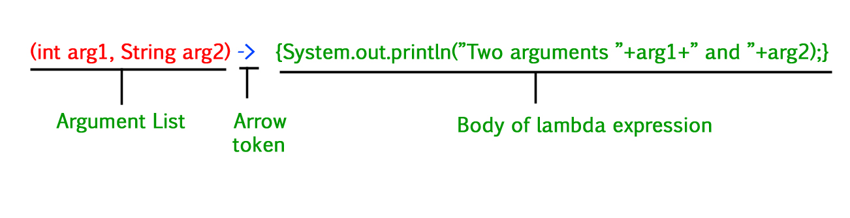
Java Lambda Expression Syntax
(argument-list) -> {body}

Slide 13
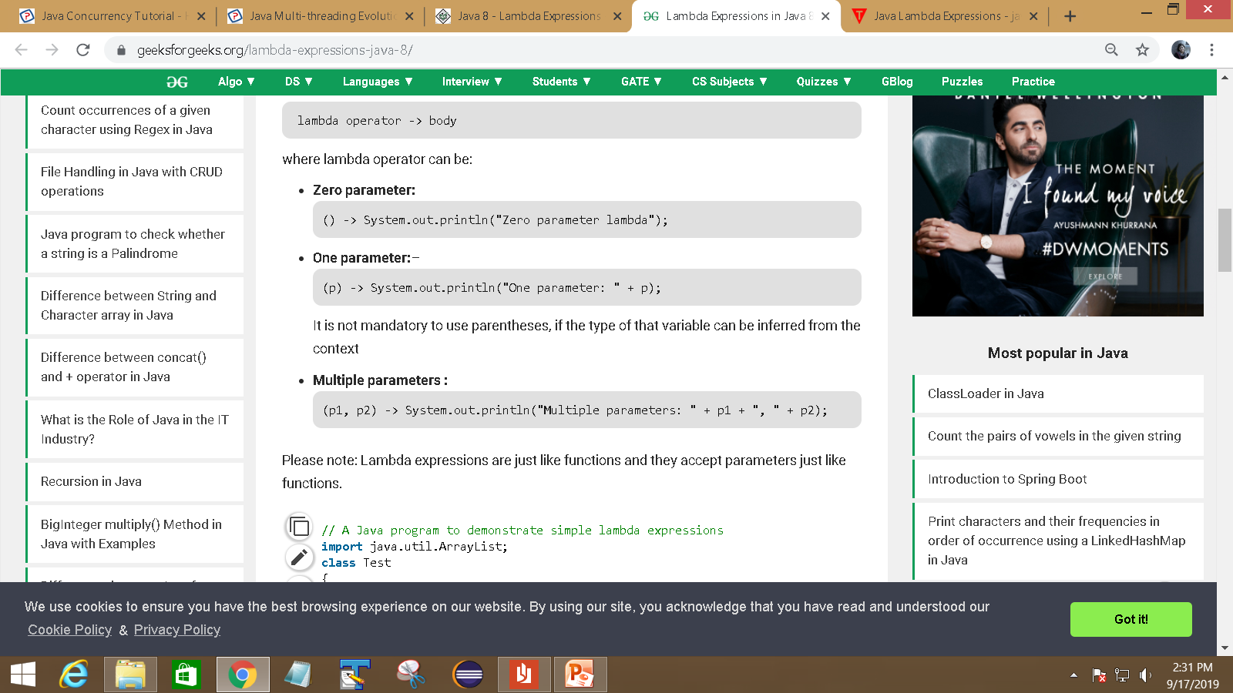

Slide 14
Example
interface Sayable{ public String say(); }
public class LambdaExpressionExample3
{
public static void main(String[] args) {
Sayable s=()->{
return “test ";
};
System.out.println(s.say());
}
}

Slide 15
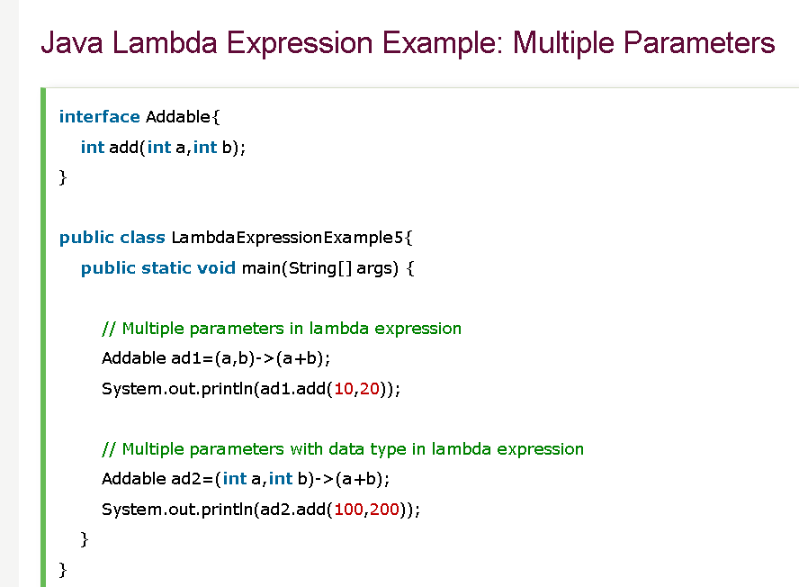

Slide 16
The lambda expression body may have
  local variables,
  statements.
  We can use break, continue, and return
  We can even throw exceptions in lambda expression body.
  A lambda expression does not have a name since it represents anonymous inner class.

Slide 17
Example
public class lambdatest
{
public static void main(String[] args) {
MyIntegerCalculator mi = (Integer s1) -> s1 * 2;
System.out.println("1- Result x2 : " + mi.calcIt(5));
}}
interface MyIntegerCalculator
{ public Integer calcIt(Integer s1); }

Slide 18
Example 2
public class Main {
public static void main(String[] argv) {
Processor stringProcessor = (str) -> str.length();// datatype is ommited
String name = "Java Lambda";
int length = stringProcessor.getStringLength(name);
System.out.println(length);
}}
@FunctionalInterface
interface Processor {
int getStringLength(String str);
}

Slide 19
We can further omit the parameter type and parentheses
Processor stringProcessor = str -> str.length();

Slide 20
No Parameters
For a lambda expression with no parameters, we still need the parentheses.
() -> { System.out.println("hi"); }

Slide 21
Lambda Expressions Body
The lambda expression body can be a block statement or a single expression.
A block statement is enclosed in braces while a single expression can exist without braces.
In the block statement we can use return statement to return value.

Slide 22
The following lambda expression uses a block statement and use return statement to return the sum.
(int x, int y) -> { return x + y; }
While the following lambda uses an expression:
(int x, int y) -> x + y

Slide 23
Lambda with collection
List<String> list=new ArrayList<String>();
list.add("ankit");
list.add("mayank");
list.add("irfan");
list.add("jai");
list.forEach(
(n)->System.out.println(n)
);

Slide 24
summary
Lambda expressions are used primarily to define inline implementation of a functional interface, i.e., an interface with a single method only.

Slide 25
What is the return type of lambda expression?
a) String
b) Object
c) void
d) Function

Slide 26
Q lambdas introduced in Java 8 allow us to treat -
a.Data as code
b.Code as data
c.none
d.all

Slide 27
Which of the following is the correct lambda expression which add two numbers and return their sum?
A - (int a, int b) -> { return a + b;};
B - (a, b) -> {return a + b;};
C - Both of the above.
D - None of the above.

Slide 28
how many methods are there in functional interface in Java 8?
a.0
b.1
c.2
d.3

